Slide 1


Slide 2

AkaBI : a definition
AKA means Also Known As
AKA means red in japanese, the colour related to the notions of challenge and passion
BI for Business Intelligence
BI for Business Innovation BI for Business Integration

Slide 3

Facts
Creation : 2011
Staff : 80 consultants
Area : Belgium/Luxembourg/Paris
Sectors of activity : Services, Telecoms, Bank, Insurance, Industry
AkaBI goes Green as from 2018

Slide 4




Slide 5
Our services
Business & IT assistance/coaching
Functional & technical studies
Training (BI AKAdemy)
Development

Slide 6


Slide 7





Slide 8

Questions?
Follow us via our Facebook AkaBI

Slide 9



Charles Godart
BI consultant
Team Manager
Event manager
Master MIAGE
Former gamer
www.akabi.eu
Charles.godart@akabi.eu
Luxembourg

Slide 10
Plan
Datawarehouse
Source system
ETL
Datamart
Reporting
Cloud vs onPremise
Business Intelligence

Slide 11
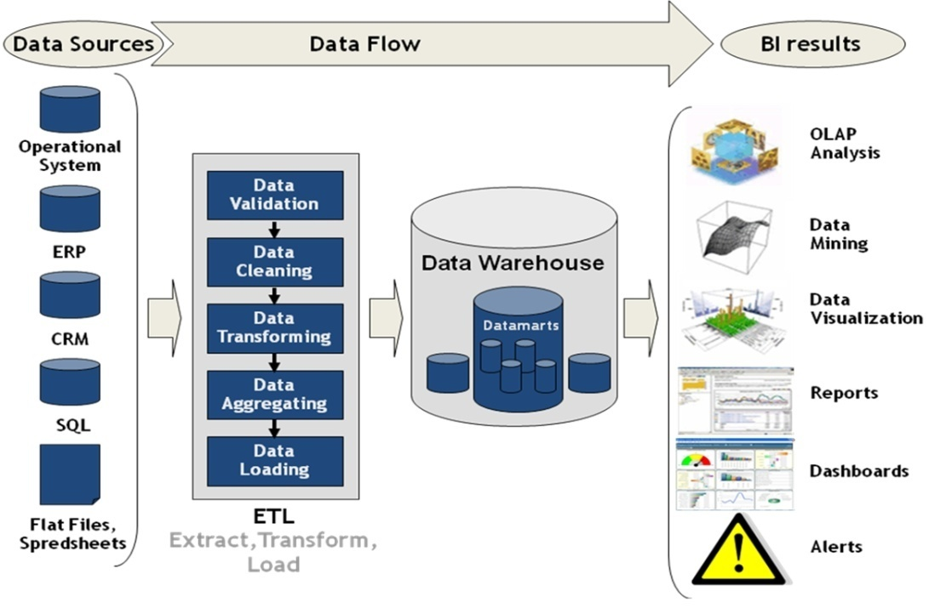
Business Intelligence Supply Chain

Slide 12
Why a Datawarehouse ?
Heterogeneous data
High data growth
Availability of the data
Low querry performance
Security issue

Slide 13
Datawarehouse advantage
Data centralisation
Better data integration and utilization
Velocity
Data sharing
Security
Data quality and non volatile
Historization

Slide 14


Datawarehouse modelisaiton
Multiple layers
Star schema
Fact vs dimension
Data historization
SQL
Oracle vs Transac SQL

Slide 15
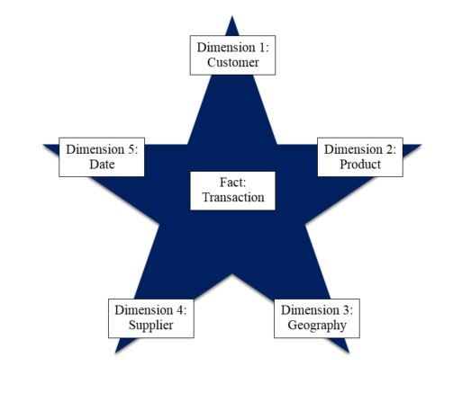

Slide 16




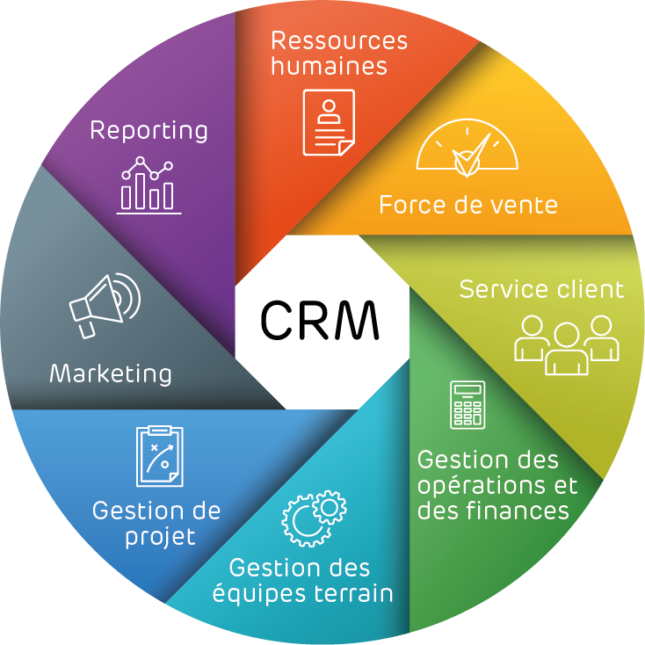

Source system

Slide 17
ETL
Data Extraction
Data Transformation
Data Loading
ETL vs ELT

Slide 18

Some ETL Tools

Slide 19
DataMart
As many as requested
Business oriented
Datawarehouse sample
Efficiency
Choice of the granularity

Slide 20
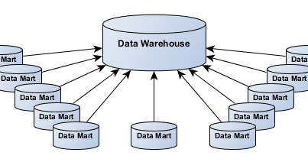

Slide 21
Reporting
User friendly
Help the business
A lot of tools
A moving world

Slide 22
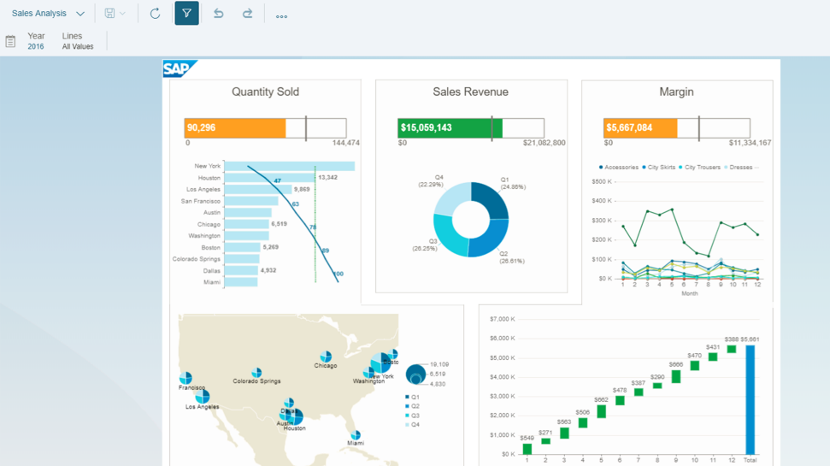
SAP BO

Slide 23
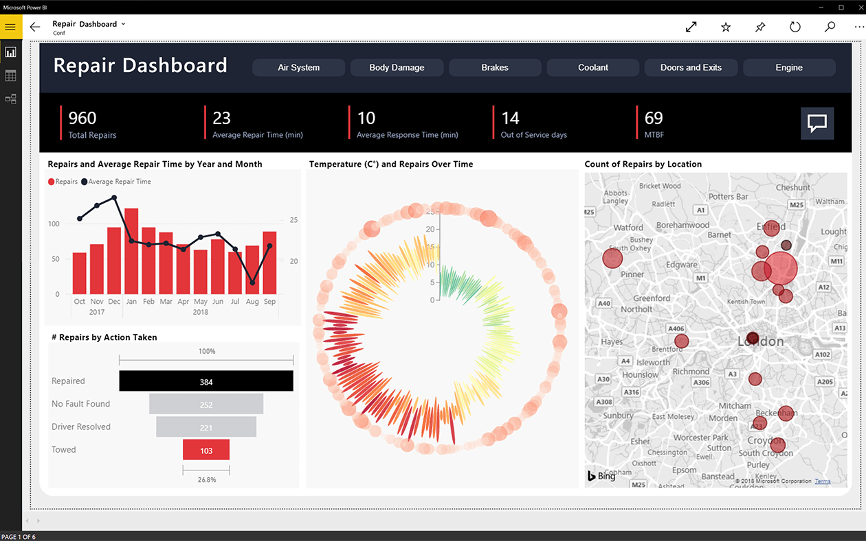
Microsoft PowerBI

Slide 24
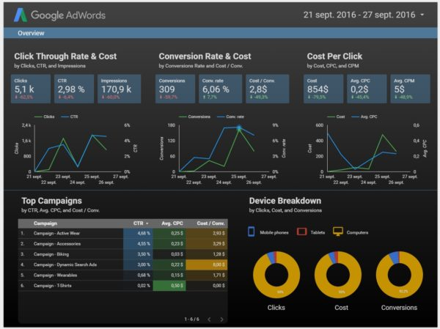
Google Data Studio

Slide 25
Cloud vs On Premise
On Premise
Cloud
Amazon Web Services (AWS)
Google Cloud Platform (GCP)
Microsoft Azure

Slide 26
Business Intelligence
Communication (data literacy)
Technical skills
Business knowledge

Slide 27



















